Slide 1
Actuarial Science (ACS)
Education Professor of Statistics
Kwong Koon Shing
FSA, CERA

Slide 2
ACS second major offered by SOE is open to all SMU students
Students with interests in mathematics, statistics, finance and insurance
Careers in actuary, finance, insurance and risk management
Education framework of the Society of Actuaries, USA
Two tracks:
Actuarial analyst (AA) track (for ASA)
Risk analyst (RA) track (for CERA)

Slide 3
What is ASA?
ASA stands for Associate of the Society of Actuaries
FSA stands for Fellow of the Society of Actuaries
FSA has six tracks:
Corporate Finance and ERM
Quantitative Finance and Investment
Individual Life & Annuities
Retirement Benefits
Group & Health
General Insurance

Slide 4
Compulsory courses for AA track
STAT 101 Introductory Statistics or STAT 151 Introduction to Statistical Theory
STAT 201 Probability Theory and Applications
STAT 203 Financial Mathematics
ECON 205 Intermediate Mathematics for Economics
ECON 101 Intermediate Microeconomics
ECON 102 Intermediate Macroeconomics
ECON 107 Introduction to Econometrics
ECON 207 Intermediate Econometrics or ECON 233 Economic Forecasting
STAT 310 Life Contingent Risks
STAT 311 Risk Theory and Loss Models or FNCE 305 Analysis of Derivative Securities
ACCT 101/111 Financial Accounting
FNCE 101 Finance
FNCE 102 Financial Instruments, Institutions and Markets or FNCE 201 Corporate Finance

Slide 5
Compulsory courses for RA track
STAT 101 Introductory Statistics or STAT 151 Introduction to Statistical Theory
STAT 201 Probability Theory and Applications
STAT 203 Financial Mathematics
ECON 205 Intermediate Mathematics for Economics
ECON 107 Introduction to Econometrics
ECON 207 Intermediate Econometrics or ECON 233 Economic Forecasting
FNCE 305 Analysis of Derivative Securities or STAT 310 Life Contingent Risks
STAT 311 Risk Theory and Loss Models
STAT313 Quantitative Risk Analysis
ACCT 101/111 Financial Accounting
FNCE 101 Finance
FNCE 102 Financial Instruments, Institutions and Markets or FNCE 201 Corporate Finance

Slide 6
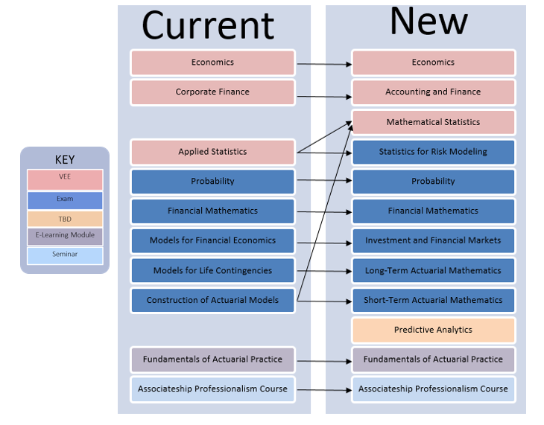
Change of ASA requirements in 2018

Slide 7
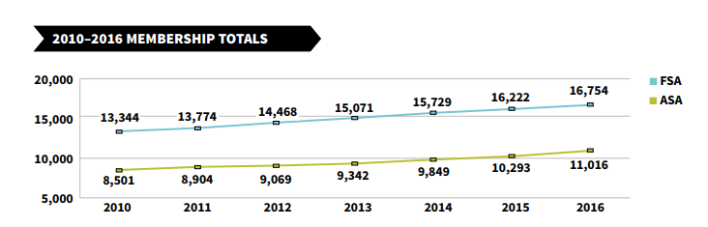
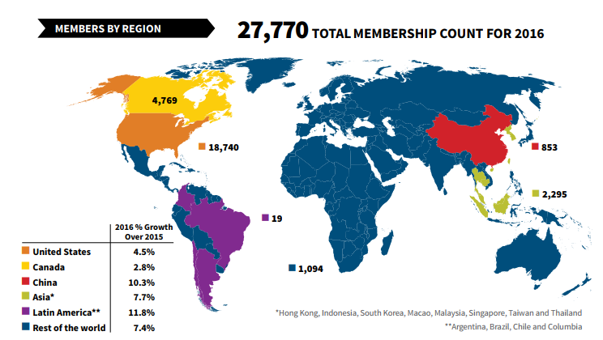
Numbers of FSA and ASA

Slide 8
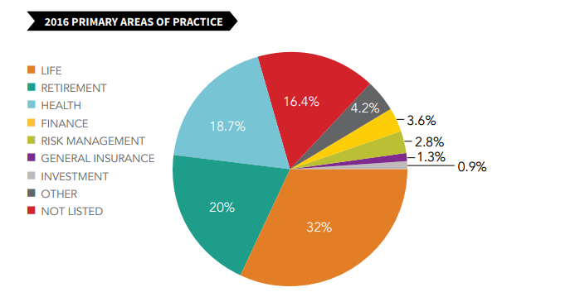

Slide 9
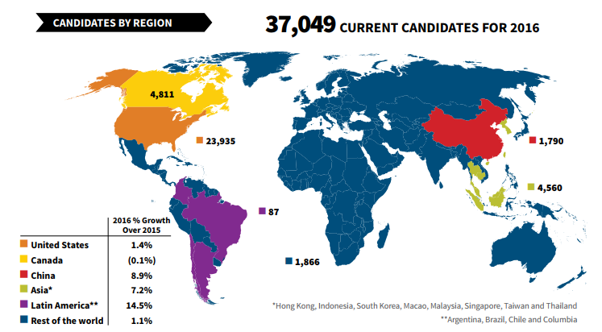
Source: 2016 SOA review

Slide 10
What does CERA stand for?

Slide 11
What is CERA?
The CERA is an international credential for professions in enterprise risk management (ERM)
It was launched in 2007 by Society of Actuaries (SOA), USA (14 organizations in 12 countries in 2009)
23 actuarial organizations have signed a global treaty establishing the CERA credential as the globally recognized ERM credential in 2017 (there were 16 organizations in 2015!)
There are six more new Acceding parties based in Austria, Belgium, Croatia, Italy and Spain in 2017.
Besides SOA Exams, you can also obtain the CERA designation by taking the exams offered in UK, Australia, Canada, etc.

Slide 12
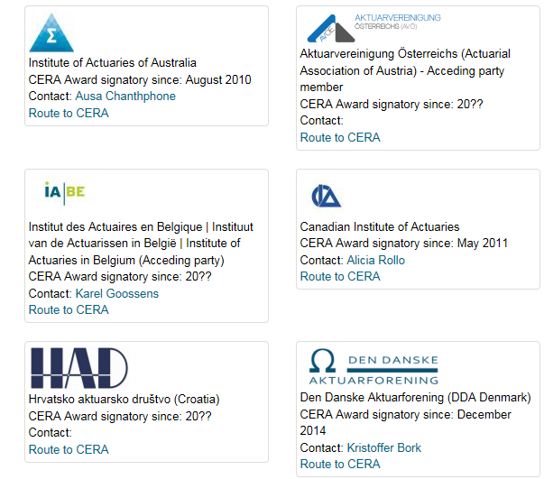
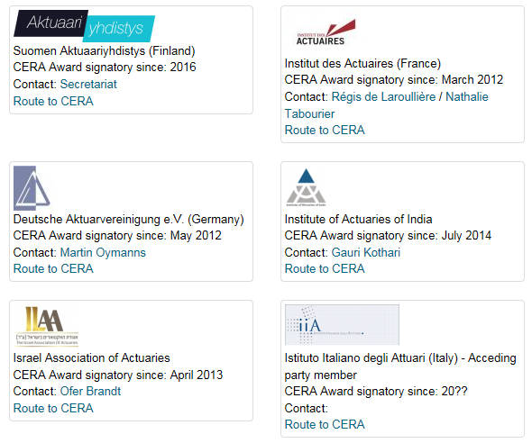
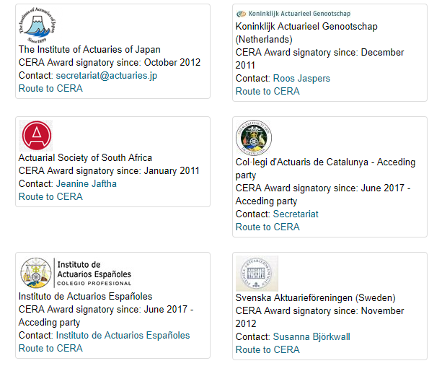
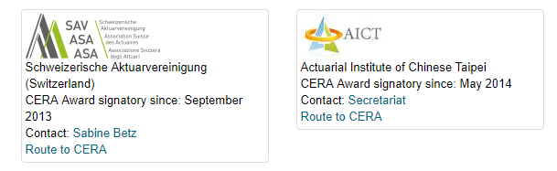
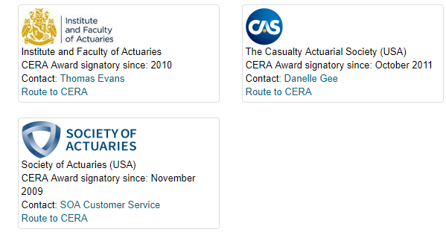
23 CERA Actuarial Organizations

Slide 13
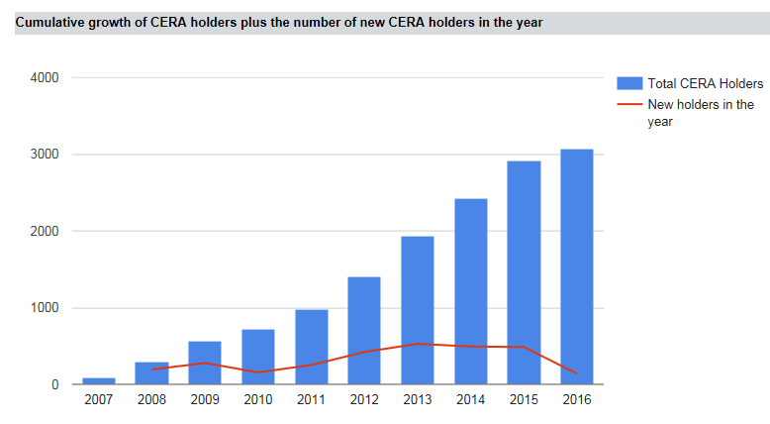

Numbers of CERA
http://www.ceraglobal.org/

Slide 14
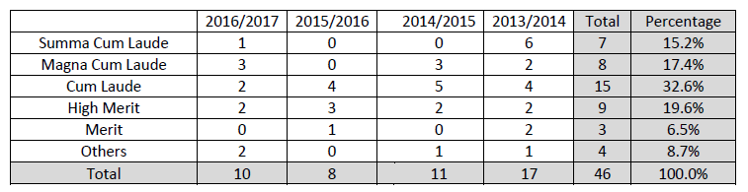
SMU ACS
AA Track: 34 (Ave GPA 3.47)
RA Track: 30 (Ave GPA 3.42)

Slide 15
THE END
http://www.ceraglobal.org/
http://www.actuaries.org.uk/
http://www.soa.org/

